Slide 1
Breast Cancer Histology Image Classification Using Deep Neural Networks
Authors: Pranab Nandy, Manas Kumar Mishra, Somoshree Datta, Sayantani Ghosh, Shubham Kumar
Mentor: Sourav Chatterjee

Slide 2
AGENDA
Introduction
Dataset
Methodology
Results
Conclusion
References

Slide 3
INTRODUCTION
Breast Cancer is ranked the number one cancer among Indian females with a rate of 25.8 per 100,000 women and a mortality rate of 12.7 per 100,000 women
Benign (Noncancerous)
Malignant (Cancerous)
Based on the penetration of the skin and can be classified into two groups:
Noninvasive
Invasive
In 2007, the number of new cases for breast cancer was 12775, while the expected number of new cancer patients in 2018 will be 18235.
Breast cancer tumors can be categorized into two broad scenarios:

Slide 4
DATASET
The image dataset contains high-resolution (2048 x 1536 pixels), uncompressed, and annotated images from the Bioimaging 2015 breast histology classification challenge.
Images in the dataset are digitized by using the same acquisition conditions, with magnification of 200 and pixel size of (0:42 microm x 0:42 microm).
Each image is labeled with one of four classes: i) in situ carcinoma, ii) invasive carcinoma,iii) normal tissue and iv) benign lesion.

Slide 5
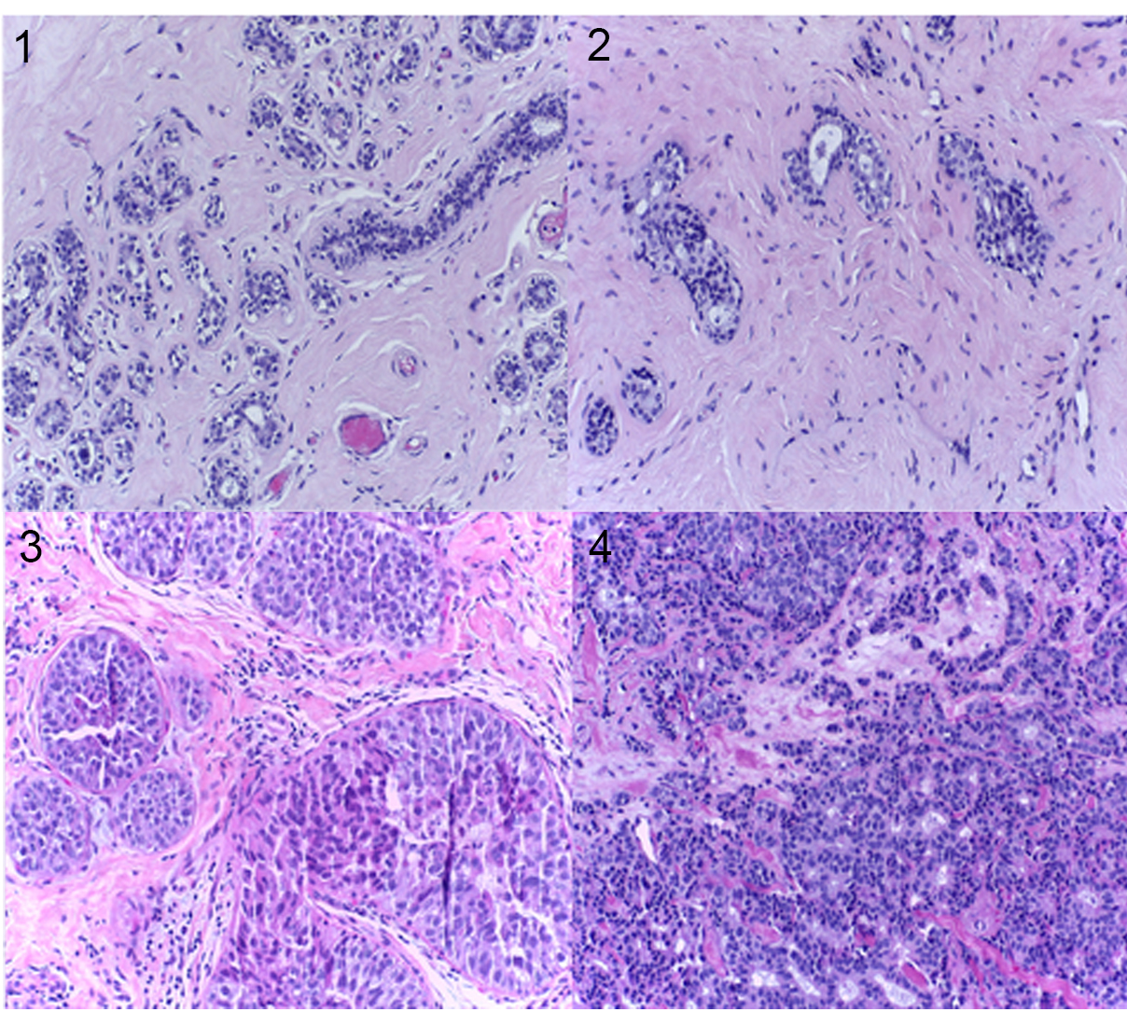
DATASET
1. Normal
4. Invasive Carcinoma
3. In Situ
2. Benign

Slide 6
METHODOLOGY
Stain Normalization
Data Augmentation
Densely Connected CNN

Slide 7
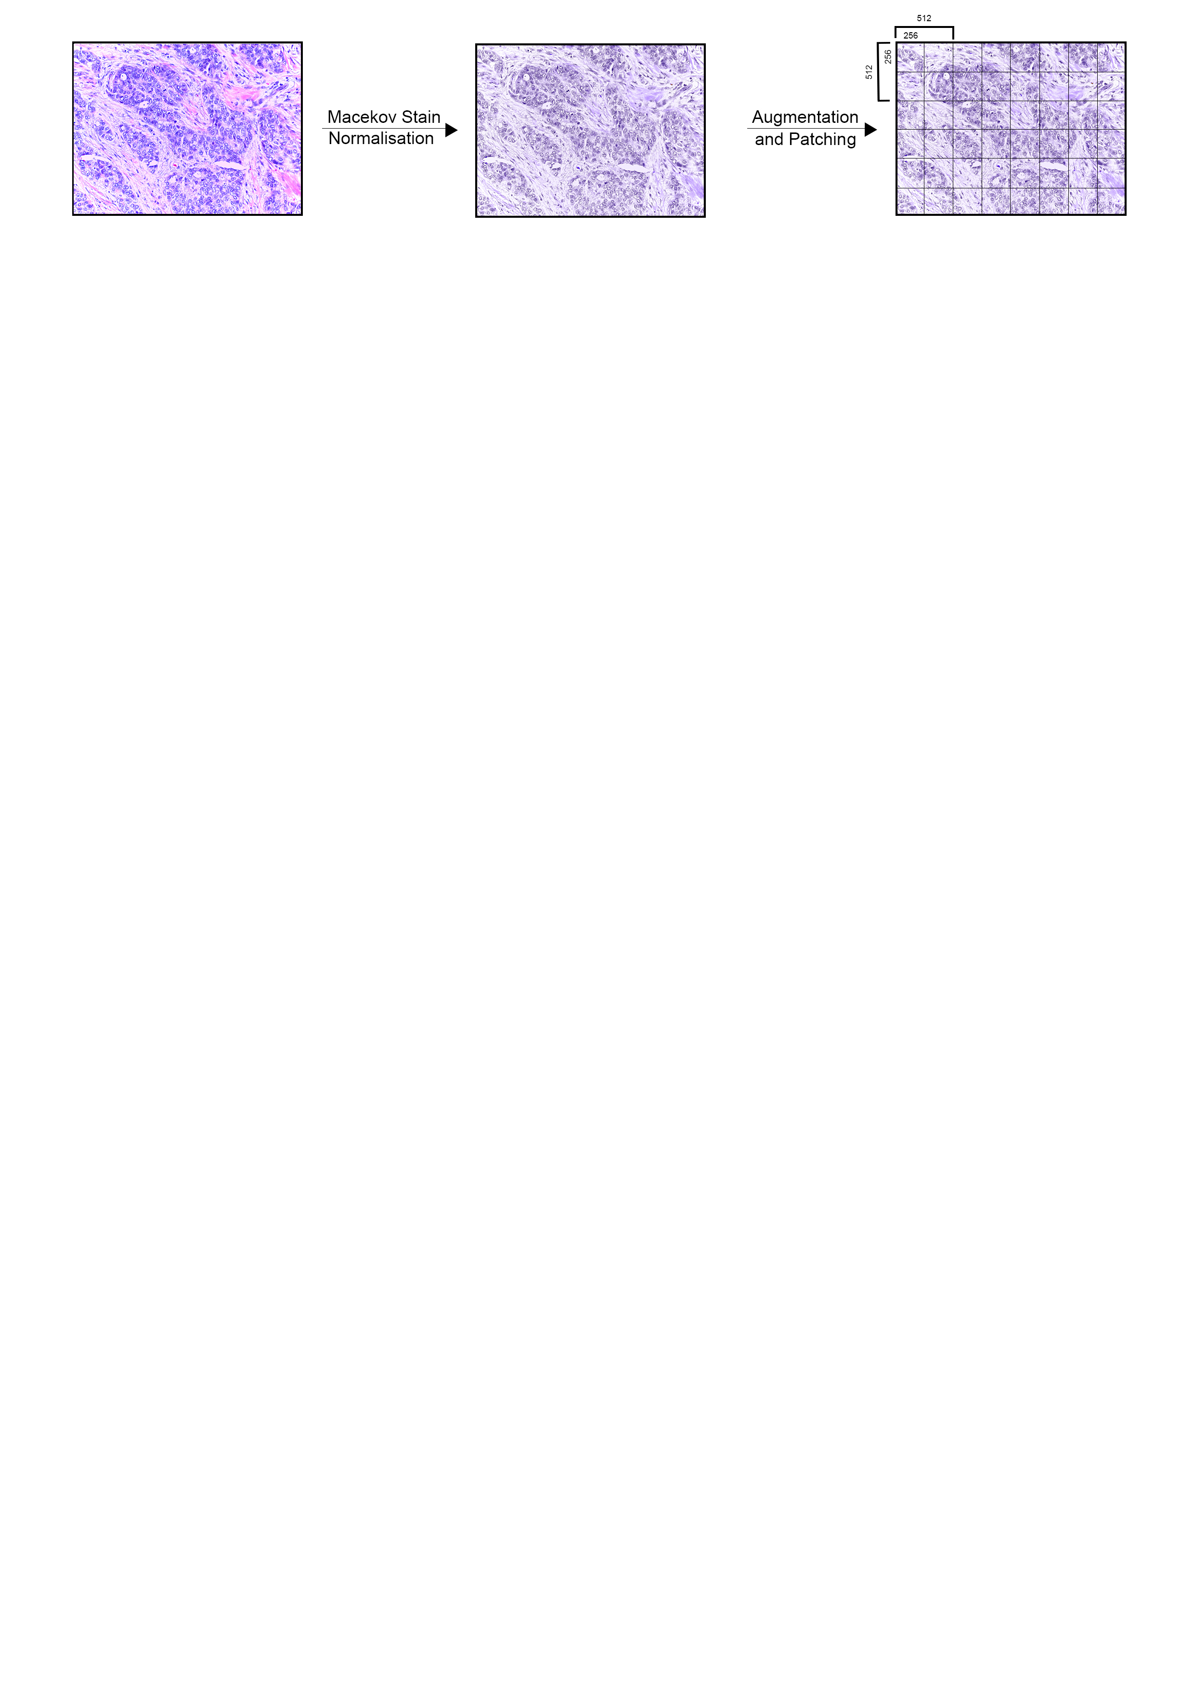
MACENKO STAIN NORMALISATION
The dataset is composed of Hematoxylin and eosin (H&E) stained breast histology microscopy so stain normalisation was necessary for training purposes.
Stain Normalization technique proposed in M. Macenko et al was used.

Slide 8
DATA AUGMENTATION USING PATCHING ,ROTATION AND FLIPPING
The image is divided in patches of 512 x 512 pixels size, with 50 percent overlap.
Eight different patches are formed from each patch by combining k*90 degrees rotations, with k values being 0, 1, 2, 3, and vertical reflections. Thus generating 280 samples from each image.
The original 250 images is thus converted into 70000 images with each of the patches having the same class label as the original image.

Slide 9
METHODOLOGY DENSELY CONNECTED CNN(DenseNet)
121-Layer DenseNet was used
Dense connections have a regularizing effect.
DenseNets are easy to train due to their improved flow of gradients.
The layers of DenseNet architecture are very narrow
DenseNet requires fewer parameters to make accurate predictions.
DenseNet combines features by concatenating them instead of summing them.

Slide 10
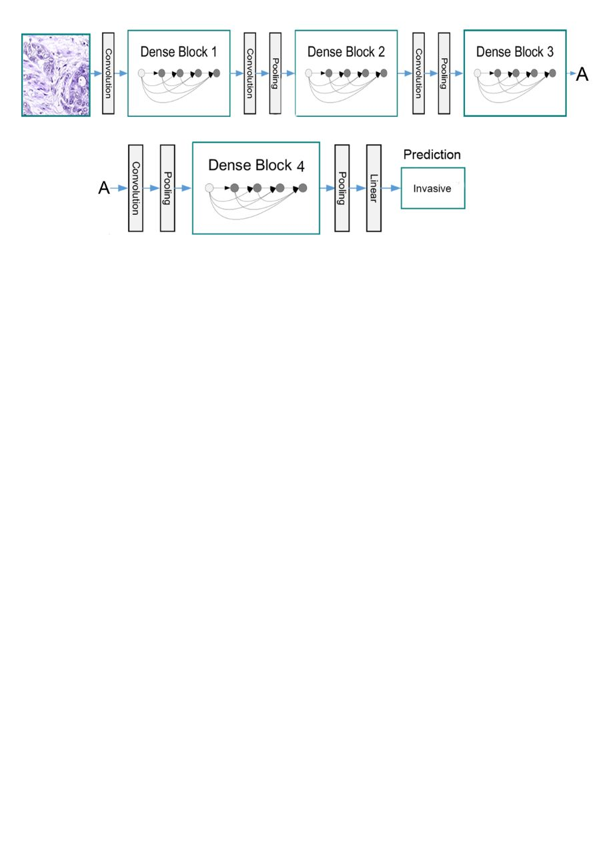
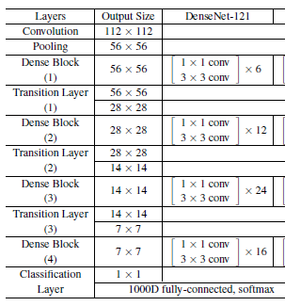
METHODOLOGY DENSELY CONNECTED CNN(DenseNet)

Slide 11
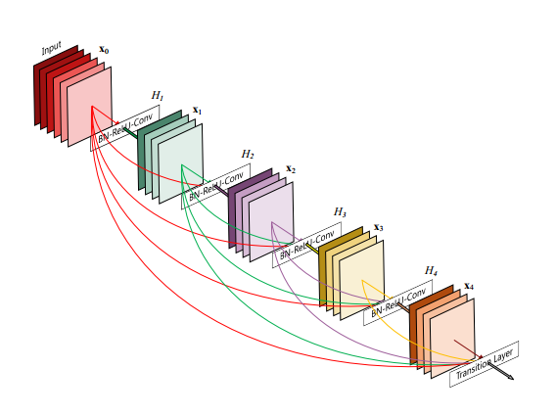
METHODOLOGY DENSELY CONNECTED CNN(DenseNet)

Slide 12
TRAINING
MACHINE SPECIFICATION
A virtual machine with the following specifications was created on Google Cloud Platform and used to train the model:
8GB RAM
220GB SSD
8 Core Processor
NVIDIA Tesla K80 Graphics Card

Slide 13
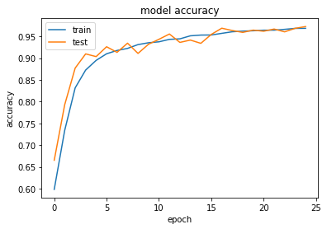
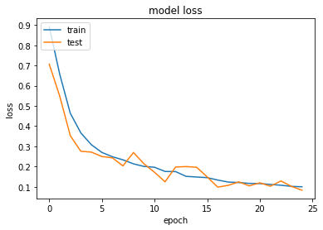
RESULTS
MODEL ACCURACY
MODEL LOSS

Slide 14
CONCLUSION
Aim was to predict the class of breast cancer from Macenko stain normalized images using a type of DNN (DenseNet)
Our results are better than all the state of the art approaches in this field, giving us a higher accuracy.
Further patching and augmentation not only helped us to increase the size of the training set which was and an important issue to resolve if we wanted to avoid overfitting.
The major problem while using DNNs for classification is feature loss with increase in number of layers, and even the smallest section of the histopathological images contains immense information.

Slide 15
KEY REFERENCES
ICIAR 2015 Grand Challenge on Breast Cancer Histology Images.
M. Macenko et al., ”A method for normalizing histology slides for quantitative analysis,” 2009 IEEE International Symposium on Biomedical Imaging: From Nano to Macro, Boston, MA, 2009.
Gao Huang, Zhuang, Liu, Laurens Van Der Maaten, Kilian Q.Weinberger, 2016. Densely Connected Convolutional Networks.
Srivastava, N., Hinton, G., Krizhevsky, A., Sutskever, I. and Salakhutdinov, R., 2014. Dropout: A simple way to prevent neural networks from overfitting. The Journal of MachineLearning Research.
Ioffe, S. and Szegedy, C., 2015. Batch normalization: Accelerating deep network training by reducing internal covariate shift. arXiv preprint arXiv:1502.03167

Slide 16
THANK YOU ☺

